Slide 1
CO456 / CO458 Web most materials adapted from Moseley (2007), Chapter 5 – supplemented with extracts from Bates (2006) and w3schools.com
Unit 5
JavaScript variables & programming structures

Slide 2
Module schedule
Wk. | Lecture/subject area(s) | Practical | Reading (Moseley, 2007)
1 | Introduction How the Web works | Internet/Web definitions and HTML report | Ch 1 (The way the Web works)
2 | HTML 1 (Introductory - inc. lists and hyperlinks) | HTML | Ch 2 pp 24-36 (HTML)
3 | HTML 2 (inc. tables, images and forms) | HTML | Ch 2 pp 36-48 (HTML) Ch 3 (XHTML and frames)
4 | CSS 1 (Introduction and core CSS principles) | CSS – introductory styles, embedded styles. | Ch 4 pp 76-96.
5 | CSS 2 (Positioning elements). | CSS– using IDs, classes and layout control. | Ch 4 pp 97-103.
6 | CSS 3 (Advanced layout & navigation) | CSS – using CSS to produce button-like navigation from HTML list elements. (CW2a to be demonstrated). | Specialised articles.
7 | JavaScript 1 (Fundamentals, variables) | JS – foundation constructs. | Ch 5 pp 108-116
8 | JavaScript 2 (Functions, branches, loops). | JS – calling functions. | Ch 5 pp 117-124.
9 | JavaScript 3 (Objects and the DOM). | JS – manipulating the DOM. | Ch 6 126-139.
10 | JavaScript 4 (Forms and validation). And DHTML | JS– validating user completed forms. | Ch 6 139-145, Ch 7.
11 | HTML5, CSS3, - media, forms, gradients, SVG (‘Edge’) and other enhancements | Web frameworks taster session 1 | See practical sheets for information sources
12 | Advanced HTML5, CSS3 & JS frameworks (e.g. jQuery, jQuery Mobile, Box2DWeb) | Web frameworks taster session 2 | See practical sheets for information sources
 | Vacation
13 | Assignment workshop 1 | Assignment workshop 1 | N/A
14 | Assignment workshop 2 | Assignment workshop 2 | N/A

Slide 3
JavaScript – what and why?
Scripting provides a means for dynamically changing content with time, according to events and by user interaction.
Client side scripts are embedded in Web pages and interpreted by browsers.
Two main client side scripting languages JavaScript and VBScript.
JavaScript was developed by Netscape Communication.
JScript is Microsoft’s version.
JavaScript was used retrospectively as the ECMA standard (European Computer Manufacturers Association).
Advantages of client side scripting are
Reduced burden on server (the client’s Web browser processes scripts)
Relatively simple for developers to use
Disadvantages client side scripting are
Visible and modifiable code
Reliance on users to have scripting/active-content enabled
Limited specification for complex processes – e.g. business/financial transactions
Local files and databases are not accessible

Slide 4
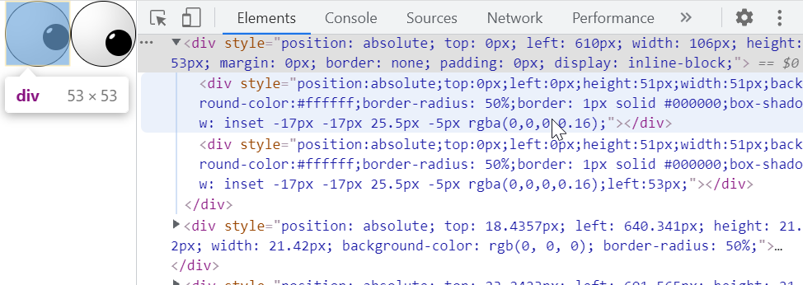
JavaScript – uses
Dynamic forms that include built-in validation and error checking
Calculators and calculation areas on pages
User interaction for warnings and getting confirmation (e.g. alert, prompt and confirm popup boxes)
Dynamically changing background and text colours, or "buttons"
To look at the URL history and take action based on it.
Open and control windows.
Provide different documents or parts thereof based on user request - e.g. framed vs not-framed
Match document versions to browser by sensing user browser applications
Image effects – buttons, slideshows
client/browser statistics reporting
click tracking
AJAX (Asynchronous JavaScript And XML) - "load-on-demand“ – allows web applications to retrieve data from the server asynchronously (in the background) without interfering with the display and behaviour of the existing page (Wikipedia)
Manipulating the DOM
“Sniffing” for plugins and browser types
Other DHTML effects
Games and fun/irritating applications

Slide 5
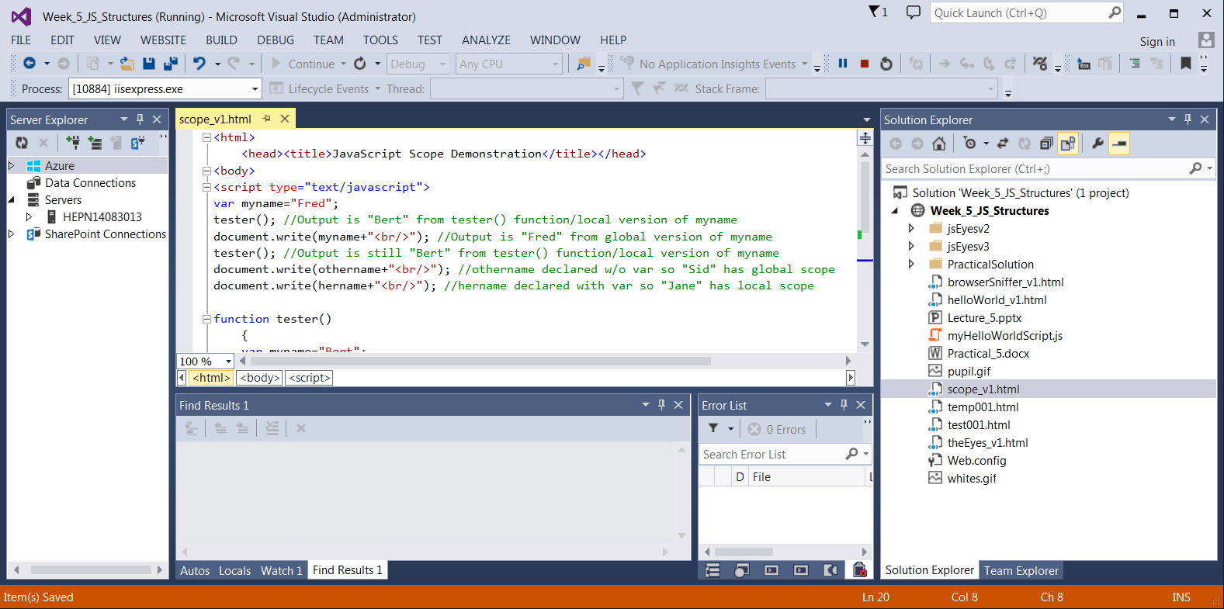
Development Environments
TextPad; MS Notepad; DreamWeaver; NotePad++; Visual Studio, Sublime Text and some great tools/plugins with FireFox and Chrome etc.
Microsoft Visual Studio

Slide 6
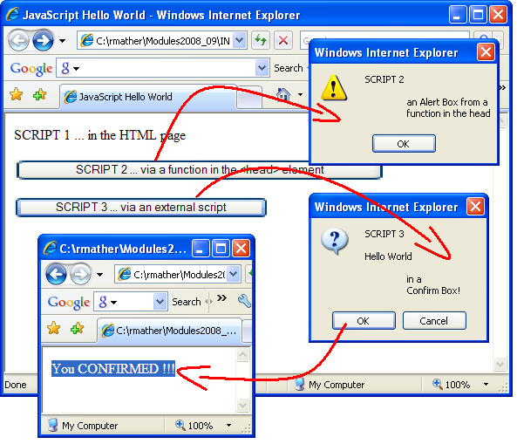
Where to put JavaScript?
Embedded in the <body>
<script type=“text/javascript”> some script here </script>
Sometimes older browsers will display code. Easily prevented by treating code as html comments at the beginning and end of scripts
<script language="JavaScript"> <!– … script here … //--> </script>
Scripts placed in the <body> are executed when the page loads
Embedded in the <head>
Useful for ‘dynamic’ available functions
e.g. user/event driven after page has loaded
External scripts
May be placed in <head> or <body>
e.g. <head><script src=“myScript.js”></script></head>
Click the image for examples

Slide 7
JavaScript - Variables
Like other programming languages, JavaScript uses variables to store information
A variable is a bit of memory with a name assigned to it
Variables may be of several primitive types
examples: [1] number; [2] string (of characters in quotes); [3] boolean (true/false); [4] null (empty); [5] function
… or may be of composite object types
JavaScript variables:
are case sensitive
cannot contain punctuation, spaces or start with digits
cannot be JavaScript reserved words
unlike C and Java, may be untyped

Slide 8
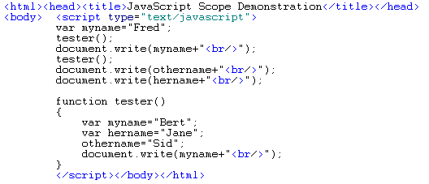
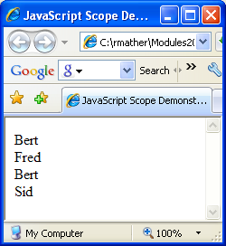
JavaScript – Variable Scope
Variables created with var (e.g. var = a; or var = a,b,c;) may have global scope depending on whether it is declared in the main program or in a function
Variables created without var will have global scope regardless of where they are declared (inside or outside functions)
Global and function (local) variables may have the same name but the latter will override the former inside the function where they are declared
Examine the scope_v1.html to determine the scopes of variables declared
Browser output … ???
Click the image for live example and code with commented solution

Slide 9
Assigning values to variables
Assign values with the “=” operator (e.g. x=123; x=“Bert”)
Assignments with simple arithmetic operators
Assignment | Alternative | Notes
x=x+1 | x++ | Increment
x=x-1 | x-- | Decrement
x=x+y | x+=y
x=x-y | x-=y
x=x*y | x*=y
x=x/y | x/=y
x=x%y | x%=y | Here % is modulus or division remainder

Slide 10
JavaScript – about “Strings”
sequences of characters
enclosed in single or double quotes
unlike C/C++/Java - no ‘char’ type for a single character
like C/C++/Java – can use escape: e.g. \n (new line) and \t (tab)
to insert HTML output into strings, you may need other escape sequences (e.g. escaping quotes \” and \’)
may be joined (‘concatenated’) with other strings and variables
myString = “my full name is ” + firstName + “ and ” + “secondName”;
a string is also an object type, therefore has internal properties (data) and methods (operations) that may be invoked
e.g. using a string property - lengthOfString = myString.length;
e.g. using a string method - thirdCharacter = myString.charAt(3);
e.g. using a string method – myString.toLowerCase()
e.g. using a string method – myString.toUpperCase()

Slide 11
JavaScript – Arrays
an array is a collection of data. It can store a list of values against a single variable name.
each element has an index for accessing/addressing
the first item/element index is zero – e.g. myArray[0] = 123;
created with a “new Array()” constructor (similar to full OO languages)
var myArray = new Array();
myArray[0] = 1; myArray[1] = 2; myArray[2] = “three”; myArray[3] = true;
may initialise values at the same time as declaring and array
var myArray = new Array(1, 2, “three”, true);
or may declare the number of elements
var myArray = new Array(15);
like strings, arrays are also of object type with internal properties (data) and methods (operations) that may be invoked
e.g. using an array property - lengthArray = myArray.length;
e.g. using an array method to sort into alhphanumeric order - myArray.sort();
using an array method to sort into reverse alhphanumeric order - myArray.reverse();

Slide 12
JavaScript exercise (see Practical Sheet)
Write a short JavaScript program that:
uses “prompt” boxes to store three names in an array;
outputs to the HTML page (i.e. using document.write() ) on three separate rows messages in the form “Hello nameX, there are the Y letters in your name”;
outputs in an “alert” box the message “Here is the list of names in alphabetical order” followed by each name sorted alphanumerically on separate rows in the alert box;
outputs an “alert” box the message “Here is the list of names in reverse alphabetical order” followed by the alphanumerically reversed list in the alert box.

Slide 13
JavaScript summary
Client-side scripting language widely used for dynamic web pages and real time user responses
Can places scripts in <head>, <body> or externally
A number of ready made pop up functions (alert, prompt, confirm)
Have covered variables, strings and arrays
NEXT WEEK – functions, branching statements and iteration (loops)

